Slide 1
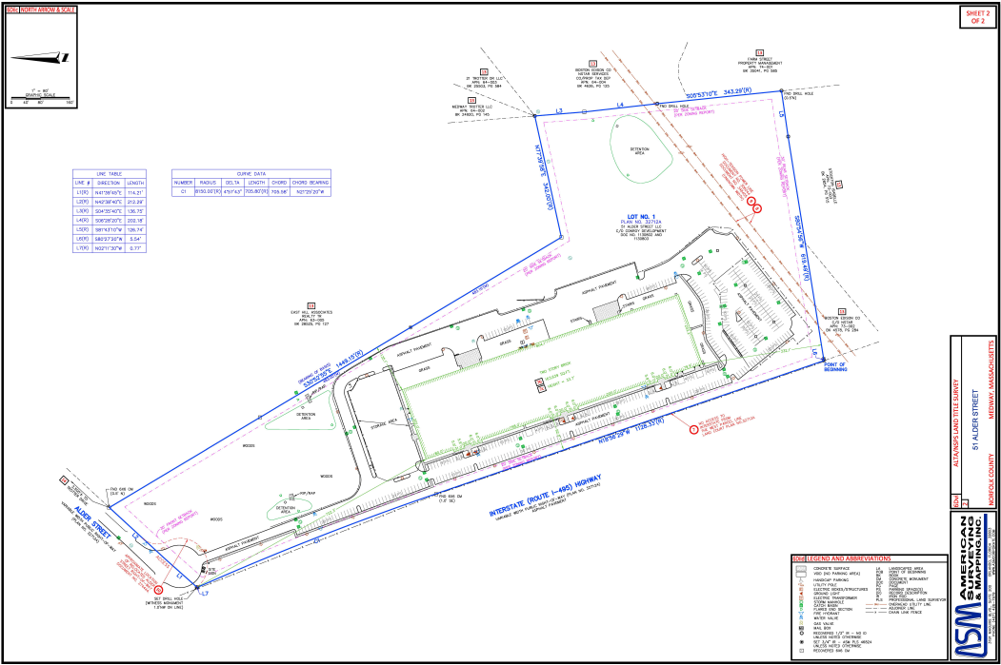
Proposal for paving the ground behind the building:
02/09/2024
AA

Slide 2
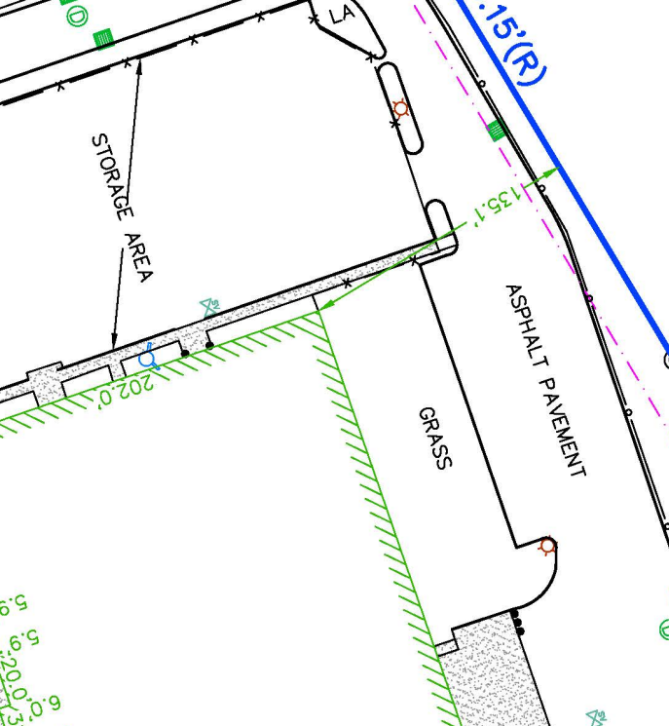
Proposal for paving the ground behind the building:
Remove trees
Remove Sidewalk
And curb
Substitute Light posts
In this area for flood Light
Attached to the building
in the future.
~3000${ft}^{2}$
02/09/2024
AA

Slide 3
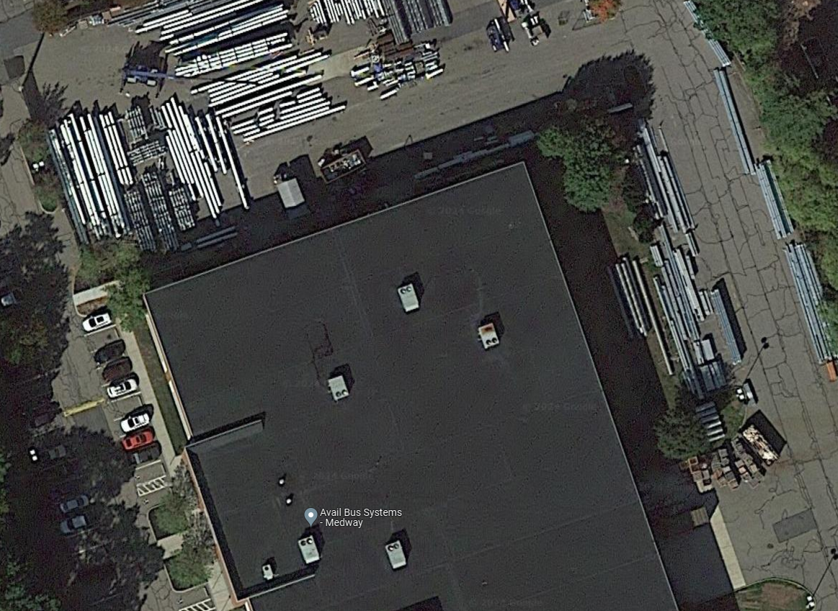
Proposal for paving the ground behind the building:
The designated area highlighted in YELLOW indicates the proposed paving zone.
The “X’s” highlighted in RED indicates the Trees, Curbs, Light Posts to be removed.
02/09/2024
AA

Slide 4
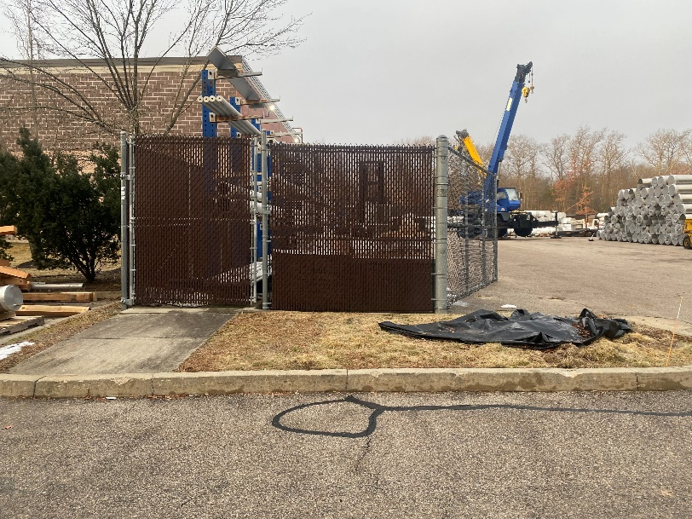
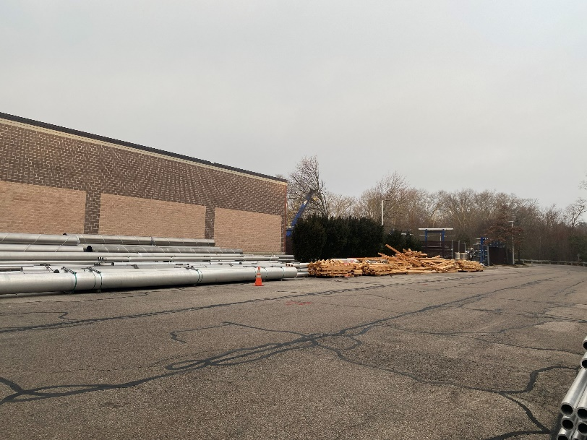
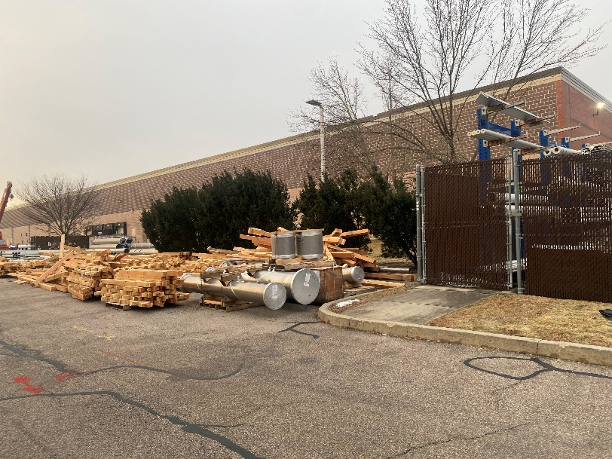
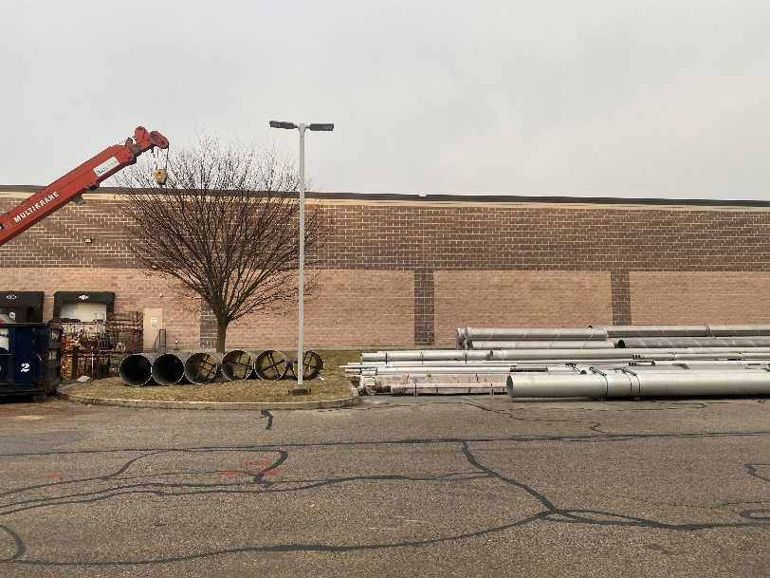
Proposal for paving the ground behind the building:
GOALS:
Sidewalk Demolition;
Tree Removal;
Light Posts Removal;
Exterior Lighting Installation;
Pave of designated Area (with suitable materials such stones or gravel).
Marked in RED Most of all the items to be removed to pave this area.
02/09/2024
AA

Slide 5
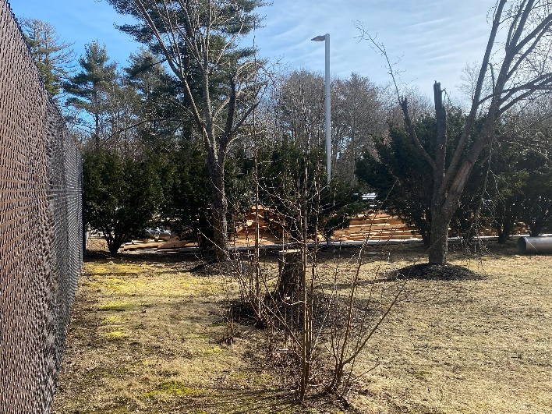
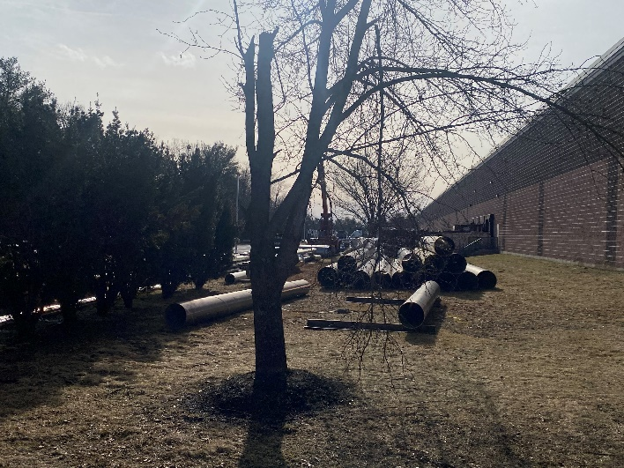
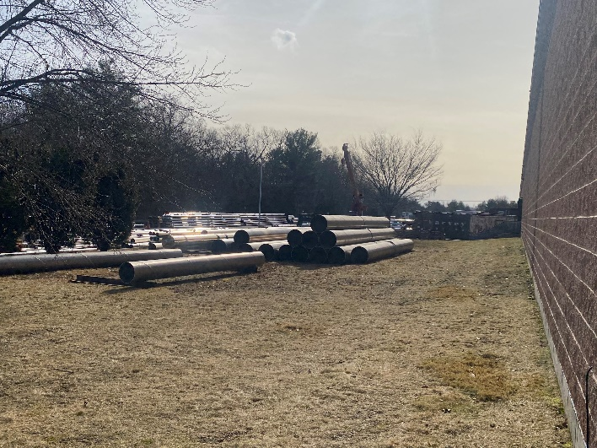
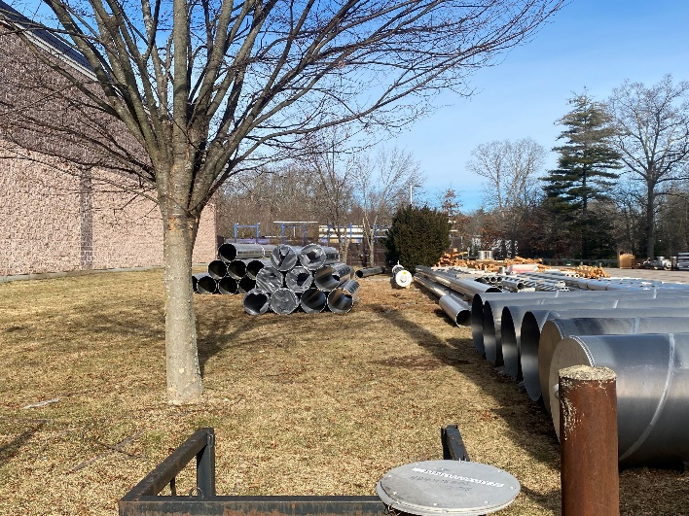
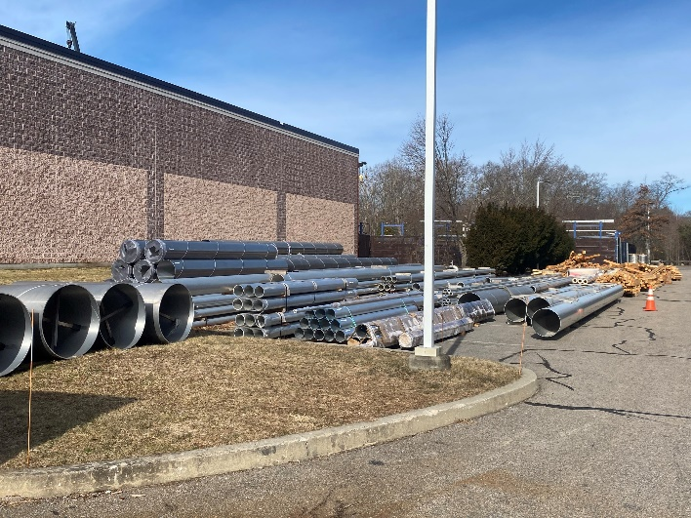
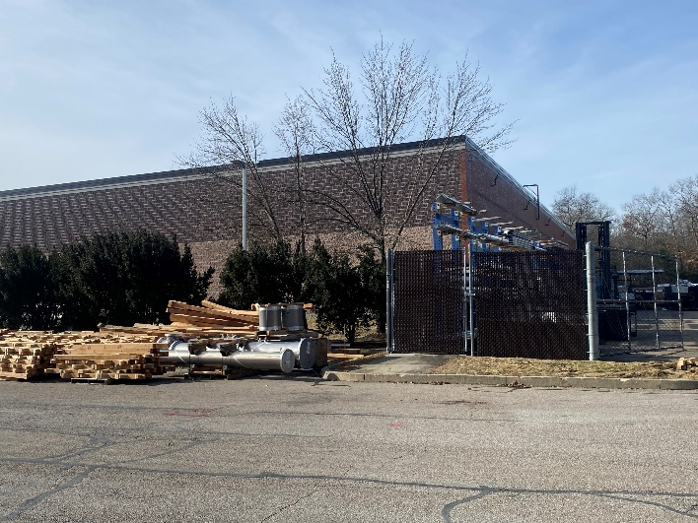
Proposal for paving the ground behind the building:
02/09/2024
AA

